Slide 1

Calculating Churn Rates
Learn SQL from Scratch

Slide 2
Table of Contents
Get familiar with Codeflix
What is the overall churn rate by month?
Compare the churn rates between segments

Slide 3
Getting Familiar with Codefix

Slide 4
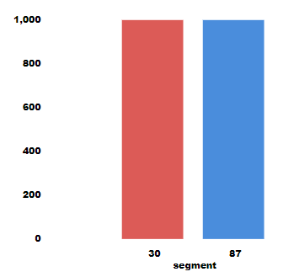
1. What is the Overall Churn by Month?
There are 3 main questions that are being asked at the beginning in regards to Codefix’s Profile.
How many months has the company been operating? The Company has been operating since December.
Which Months do you have enough information to calculate a churn rate? Due to the 1 month Minimum we only have 3 months to calculate.
What Segments of Users exist? There are 2 segments available, 1000 users by segment.
-- Taking a look at the specifics of the data
SELECT *
FROM subscriptions
LIMIT 100;
-- How many months the company has been operating?
SELECT MIN(subscription_start),MAX(subscription_start)
FROM subscriptions;
-- SELECT THE NUMBER OF DISTINCT SEGMENTS, count the number of users in each segment
SELECT DISTINCT segment, COUNT(*) as 'Number of customers'
FROM subscriptions
GROUP BY segment;

Slide 5
What is the Overall Churn by Month?

Slide 6
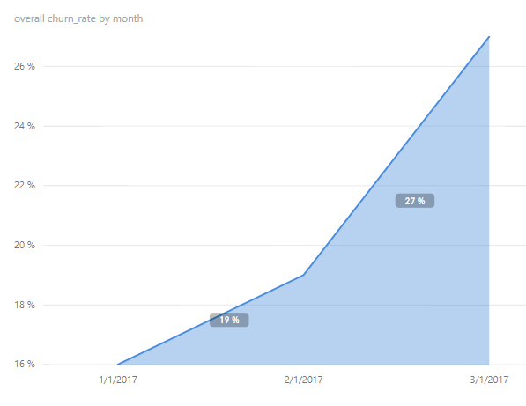
2. What is the overall churn by month?
In order to find the overall churn by month, we create a temp table for our months. Cross join with subscription table and create our alias fields thru case statements. We aggregate the segments and apply the calculation of ROUND(1.0*sum_canceled/sum_active,2).
Based on the results there seems to be an issue with Codefix’s customer retention, especially month over month.
-- CREATE A temporary table for MONTHS and Utilize a cross join along with case statement to convert active subs into flag column 1 or 0
WITH months AS
(SELECT
'2017-01-01' as first_day,
'2017-01-31' as last_day
UNION
SELECT
'2017-02-01' as first_day,
'2017-02-28' as last_day
UNION
SELECT
'2017-03-01' as first_day,
'2017-03-31' as last_day
),
cross_join AS
(SELECT *
FROM subscriptions
CROSS JOIN months),
status AS
(SELECT id, first_day as month,
-- The is total active segment
CASE
WHEN (subscription_start < first_day)
AND (
subscription_end > first_day
OR subscription_end IS NULL
)
THEN 1
ELSE 0
END as is_active,
-- Here we'll create out cancelled segments
CASE
WHEN (subscription_end BETWEEN first_day AND last_day)
THEN 1
ELSE 0
END as is_canceled
FROM cross_join),
-- Lets compute our Aggregate numbers for both segments
status_aggregate AS
(SELECT
month,
SUM(is_active) as sum_active,
SUM(is_canceled) as sum_canceled
FROM status
GROUP BY month)
-- Compute the Churn Rates and round the rates
SELECT month,
ROUND(1.0*sum_canceled/sum_active,2) as 'overall churn_rate'
FROM status_aggregate;

Slide 7
Comparing Churn Rates Between Segments.

Slide 8
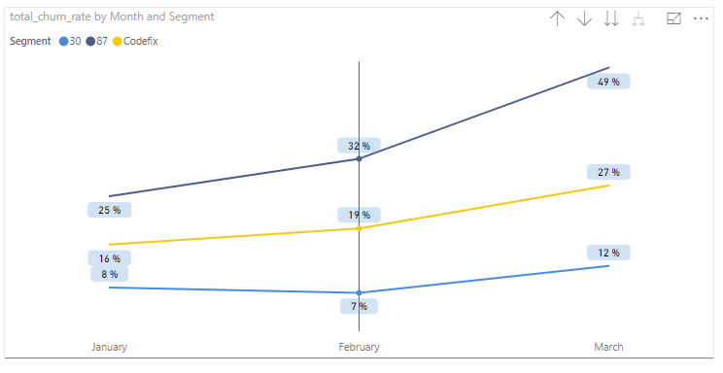
3. Comparing churn rates by segments.
-- These are the active 87 segments
CASE
WHEN (subscription_start < first_day)
AND (
subscription_end > first_day
OR subscription_end IS NULL
)
AND segment = 87
THEN 1
ELSE 0
END as is_active_87,
-- This would be the cancelled 87 segments
CASE
WHEN (subscription_end BETWEEN first_day AND last_day) AND ( segment= 87)
THEN 1
ELSE 0
END as is_canceled_87,
-- This is active 30 segments
CASE
WHEN (subscription_start < first_day)
AND (
subscription_end > first_day
OR subscription_end IS NULL
)
AND segment = 30
THEN 1
ELSE 0
END as is_active_30,
-- These are the cancelled 30 segments
CASE
WHEN (subscription_end BETWEEN first_day AND last_day) AND ( segment= 30)
THEN 1
ELSE 0
END as is_canceled_30
FROM cross_join),
-- Now we'll generate the Aggregate numbers for both segments
status_aggregate AS
(SELECT
month,
SUM(is_active) as sum_active,
SUM(is_active_30) as sum_active_30,
SUM(is_active_87) as sum_active_87,
SUM(is_canceled) as sum_canceled,
SUM(is_canceled_30) as sum_canceled_30,
SUM(is_canceled_87) as sum_canceled_87
FROM status
GROUP BY month)
-- Compute the Churn Rates & Round
SELECT month,
ROUND(1.0*sum_canceled/sum_active,2) as total_churn_rate,
ROUND(1.0*sum_canceled_30/sum_active_30,2) as churn_rate_30,
ROUND(1.0*sum_canceled_87/sum_active_87,2) as churn_rate_87
FROM status_aggregate;
To compare churn rates by segments the process is very similar to finding the overall churn rate of the company with some additional steps. I’ll include those steps in the figure on the right →.
We differentiate the segments, aggregate and then apply our formula.
SELECT month,
ROUND(1.0*sum_canceled/sum_active,2) as total_churn_rate,
ROUND(1.0*sum_canceled_30/sum_active_30,2) as churn_rate_30,
ROUND(1.0*sum_canceled_87/sum_active_87,2) as churn_rate_87
FROM status_aggregate;
After running our query we can see distinctively that our 87 segment customers are churning at a considerable rate to that of our 30 segment customers. There might be a price sensitivity to this segment. A targeted marketing campaign with some discounts could alleviate this issue.

